Slide 1

SUBMITTED BY: Kritika Agarwal 2021889
ATTENDANCE AUTOMATION USING FACE RECOGNITION
MENTOR NAME:
DR. NEERAJ KUMAR PANDEY

Slide 2

introduction
Automated Identification
Face recognition technology automates attendance tracking by identifying individuals based on their facial features.
Enhanced Security
Face recognition systems offer enhanced security and accuracy compared to traditional methods.
Real-Time Tracking
The technology enables real-time attendance tracking, providing accurate and up-to-date attendance data.

Slide 3
Problem statement
01 Time-Consuming Process
Traditional attendance tracking methods are labour-intensive and time-consuming, leading to inefficiencies.
02 Error-Prone
Manual attendance systems are susceptible to errors, leading to inaccurate records and payroll discrepancies.
03 Lack of Real-Time Data
Manual systems lack real-time data, hindering timely decision-making and attendance monitoring.

Slide 4



METHODOLOGY
System Architecture:
Camera Integration
Integration of high-resolution cameras for capturing facial features and attendance data.
Cloud-Based Storage
Utilization of cloud-based storage for secure and accessible attendance records.
Data Processing
Implementation of robust algorithms for facial recognition and attendance data processing.

Slide 5
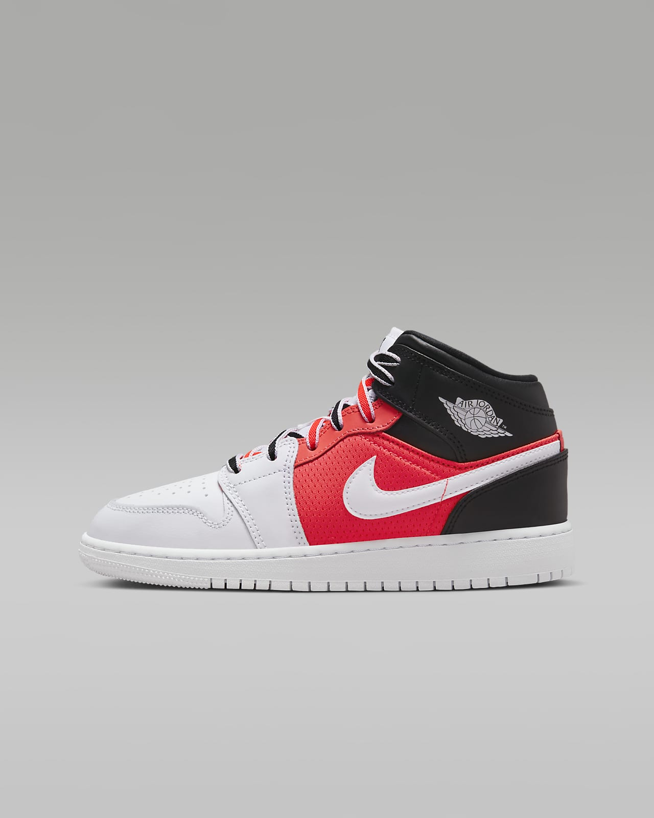


User Experience
Seamless Registration
User-friendly registration process for employees to enroll their facial features into the system.
Attendance Capture
Simple and quick attendance capture process through facial recognition at designated checkpoints.
Mobile Accessibility
Mobile integration for employees to access their attendance records and manage their profiles.

Slide 6
Data Privacy and Security
01
Compliance Measures
Implementation of data privacy measures to ensure compliance with privacy regulations.
02
Encryption Protocols
Employment of encryption protocols to safeguard facial recognition data and attendance records.
03
Access Control
Role-based access control to restrict unauthorized access to sensitive attendance data.

Slide 7



RESULTS AND DISCUSSION
Operational Efficiency
Time Savings
Automated attendance tracking saves time for both employees and administrative staff.
Resource Optimization
Efficient allocation of resources with streamlined attendance management processes.
Real-Time Insights
Access to real-time attendance data for informed decision-making.

Slide 8

Ethical and Legal Considerations
Privacy Protection
Upholding stringent privacy measures to protect facial recognition data and employee privacy.
Legal Compliance
Adherence to evolving legal frameworks and regulations governing biometric data and facial recognition technology.
Ethical Use
Ensuring ethical use of facial recognition technology in the context of attendance management.

Slide 9


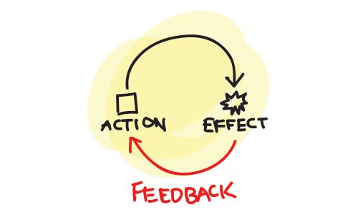
Overcoming Challenges and Future Considerations
Change Management
Employee Training
Comprehensive training programs to familiarize employees with the new attendance system.
Change Communication
Effective communication strategies to address employee concerns and promote acceptance.
Feedback Mechanism
Establishing a feedback mechanism to address user experience and system improvements.

Slide 10
Future Outlook and Innovation
01
Predictive Analytics
Exploration of predictive analytics for attendance forecasting and trend analysis.
02
Biometric Integration
Integration of additional biometric modalities for multi-factor authentication and enhanced security.
03
AI and Automation
Leveraging AI and automation for advanced attendance management capabilities.

Slide 11

Thank you

